Slide 1
Actor Critic Methods: From Paper to Code
Review of Fundamental Concepts

Slide 2




Agent, Environment, Action

Slide 3
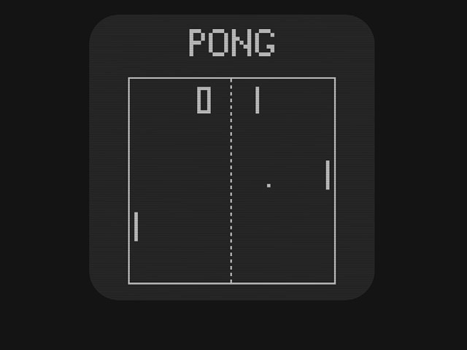

Markov Decision Process
State depends only on previous state and action
Markov Decision Process
( S₁ , A₁ , R₁ , S₂ , A ₂ , R₂ , ...)

Slide 4


Episodic Returns
These states have value
Present rewards worth more
∞
G =R + γ R + γ² R =∑ γ ^{k} R
k =0
t
t +1
t +2
t + 3
t +k +1
Sum of discounted rewards → Episode return

Slide 5
Reward Discounting
2 3
G_{t} =R_{t +1}+ γ R_{t +2} + γ R_{t + 3}+ γ R_{t +4} +...
_{G} 2
_{t} =R_{t +1}+ γ ( R_{t +2}+ γ R_{t +3} + γ R_{t + 4} +...)
^{G}t ^{=R}t +1^{+ γ G}t +1
But wait… how can we know future rewards?

Slide 6


The Agent’s Policy
Mapping of states to actions
Can be probabilistic
Π

Slide 7
Value and Action Value Functions
∞
∑
k =0
k
v
( s)=E
[ G |S =s ]=E [
γ R
|S =s ] for all s∈ S
π
π
t t
π
t + k +1 t
∞
∑
k = 0
k
q ( s ,a )=E
[G_{t}|S_{t} =s, A_{t} =a]=E [
γ R
|S =s, A =a] for all s∈ S
π
π
π
t + k +1 t
t

Slide 8


Learning from Experience
Interact with environment
Keep track of rewards
Monte Carlo Methods

Slide 9
The Bellman Equation
∞
∑
k =0
k
v _{π} ( s)=E_{π} [ G_{t}|S_{t} =s ]=E [
γ R
|S =s ] for all s∈ S
π
t + k +1 t
^{G}t ^{=R}t +1^{+ γ G}t +1
v _{π} ( s)=E_{π} [ R_{t+1} +γ G_{t +1}|S_{t} =s ]
v _{π} ( s)=∑ π (a , s)∑ ∑ p (s ' , r|s , a)[ r +γ E _{π} [ G_{t +1}|S_{t +1}=s' ]]
a s' r
v _{π} ( s)=∑ π (a , s)∑ p (s ' ,r|s ,a )[r +γ
v_{π} (s ' )]
a s' , r
Bellman Equation
q_{π} ( s ,a )=∑ p (s ' ,r|s , a)[r +γ ∑ π (a '|s ' ) q_{π} (s ' , a' )]
s' , r a'

Slide 10
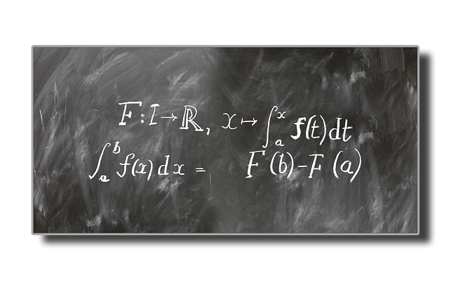
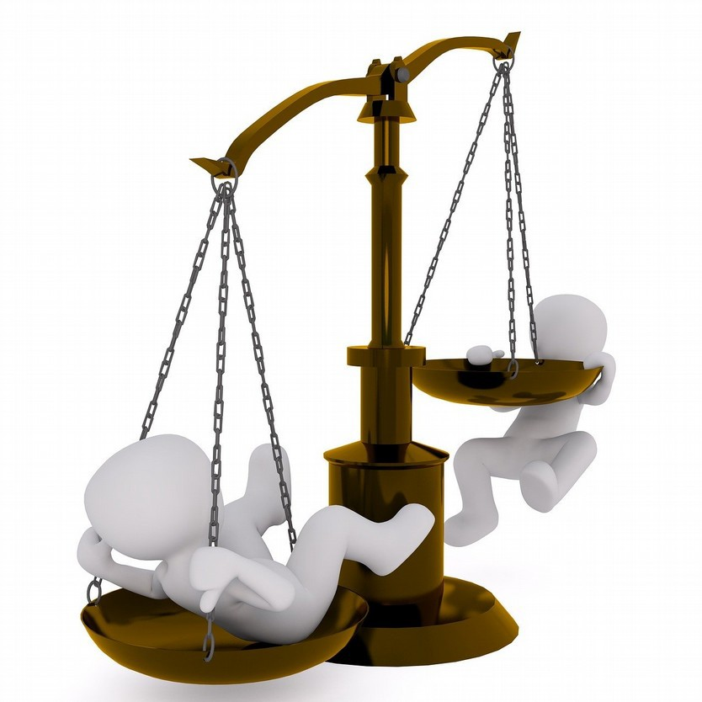


Optimal Policies
Compare policies
Known dynamics → Model based
Unknown dynamics → Model free
Exploration

Slide 11
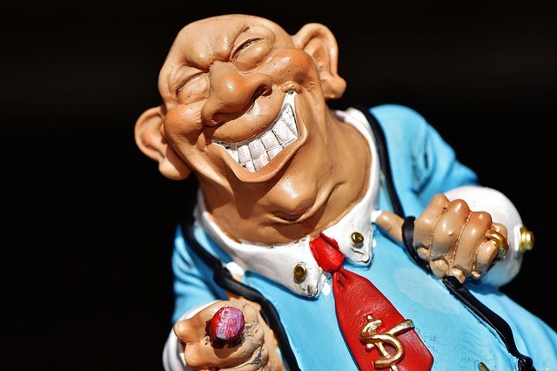

Explore Exploit Dilemma
Epsilon greedy (Q Learning)
Approximate Policy Directly

Slide 12
On Policy vs. Off Policy
●
One policy generates actions and updates value function → On policy
●
One policy generates actions and another policy updates value function → Off policy
●
Epsilon greedy → off policy learning
●
Policy gradients → on policy learning

Slide 13
Conclusions
●
Keep track of rewards to estimate value and action value functions
●
Recursive relationship between functions
●
Have to interact w/ environment to learn dynamics
●
Policy gradient & Actor critic → on policy model free

Slide 14


